Slide 1


Slide 2
PROJECT PRESENTATION ON FACE DETECTION FOR ATTENDANCE
SUBMITTED TO : -
SUBMITTED BY : -
Mr. Manoj Kumar
(Assistant Professor)
GUIDED BY : -
Mr. Lalit Kumar Narayan
(Assistant Professor)
Amisha Saxena (1801413001)
Mansi Chandra (1801413029)
Tamanna Jawrani (1801413056)

Slide 3
ACKNOWLEDGEMENT
We would like to express our sincere gratitude to our Project Incharge Mr. Manoj Kumar and our Project Guide Mr. Lalit Kumar Narayan for providing their invaluable guidance, comments and suggestions throughout our project.
We would specially thank Mr. Lalit Kumar Narayan for constantly helping us providing suggestions to improve our project.

Slide 4
TABLE OF CONTENTS
INTRODUCTION
MOTIVATION
PROBLEM FORMULATION
DEFINITION
SCOPE
TOOLS AND TECHNOLOGY
METHODOLOGY
FEATURES
LEARNING AND EXPERIENCE
FUTURE ENHANCEMENT
CONCLUSION
REFERNCES

Slide 5
INTRODUCTION
In the 21st century , everything around us has become depends upon technology to
make our life much easier.
Daily tasks are continuously becoming computerized.
To the best of our knowledge , the process of recording student’s attendance.
The main objective of this project is to offer system that simplify and automate the process of recording and tracking student’s attendance through face detection technology.
Face detection is widely used in nowadays in different areas such as universities , banks , airports , offices , etc.

Slide 6
MOTIVATION
Face recognition has recently received a blooming attention and interest from the scientific community as well as from the general public.
The interest from the general public is mostly due to the recent events of terror around the world, which has increased the demand for useful security systems.
We are using this technology for automatic attendance system which can help the lecturers to maintain the attendance records of students without wasting the paper and time.

Slide 7
PROBLEM FORMULATION
Taking and tracking student’s attendance manually, losing attendance sheets, wasted time and high error scales are problems facing the lecturers use the existing attendance system.
It is a hard process, take time and cause a lot of paper-bIt is a hard process, take time and cause a lot of paper-based work.
As a result, in order to solve these problems and avoid errors, we can use the technology like face detection to computerize this process by providing a system that record and manage student’s attendance automatically without needing to lecturer’s interference.

Slide 8
DEFINITION
FACE RECOGNITION :- It is a biometric method of identifying
an individual by comparing live capture or digital image data with the
stored record for that person.
FACE RECOGNITION ATTENDANCE SYSTEM :- It is
marking of attendance based on this technology.

Slide 9
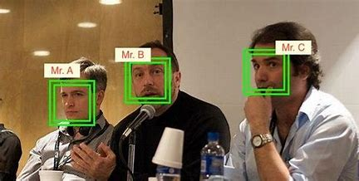

Slide 10
SCOPE
Provides an automated attendance system that is practical reliable and disturbance and time loss of traditional attendance systems.
Present a system that can accurately evaluate student’s performance depending on their recorded attendance rate.
Provides a valuable attendance service for both teachers and students.
Reduce manual process errors by provide automated and a reliable attendance system uses face recognition technology.
Produce monthly reports for lecturers.

Slide 11
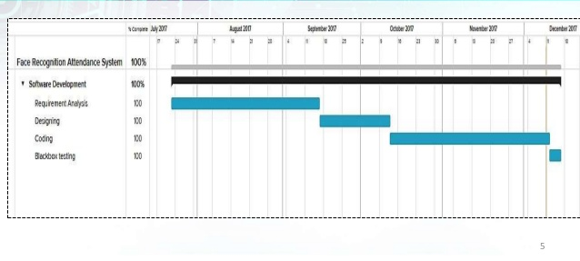
PROJECT STATUS : COMPLETED

Slide 12
TOOLS AND TECHNOLOGY
System Requirements:
System Type - 64 Bit Operating System
RAM - 4 GB
Processor - INTEL CORE i3 (2.30 GHz)
Technology Used: -
Language used - Python 3.8.3 (Anaconda)
Libraries used - Open-CV
Face-recognition
dib
NumPy
Editor: -
VS Code

Slide 13
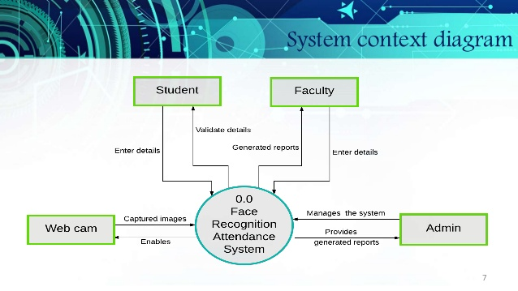
SYSTEM CONTEXT DIAGRAM

Slide 14
METHODOLOGY
Basic Face Matching : -
First, we get the location of where exactly the face is in the image using face_location() method (which gets the outline of the face) on the RGB image.
Then face encodings(markings of eyes, nose, mouth, jaws which remain the same for different images of the same person) are taken using face_encodings() function which returns a list containing 128 measurements.
Both these two steps are followed for the original and test image.
Then a comparison between these two returned lists is done by the function compare_faces() which returns a list of boolean values(True or False).
The face distance function gets the value of that by how much the two images differ.

Slide 15
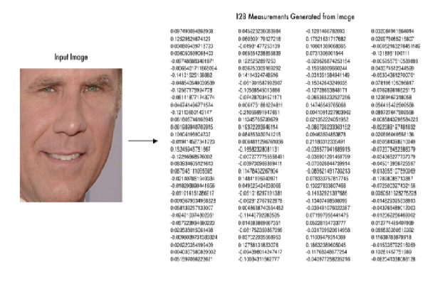

Slide 16
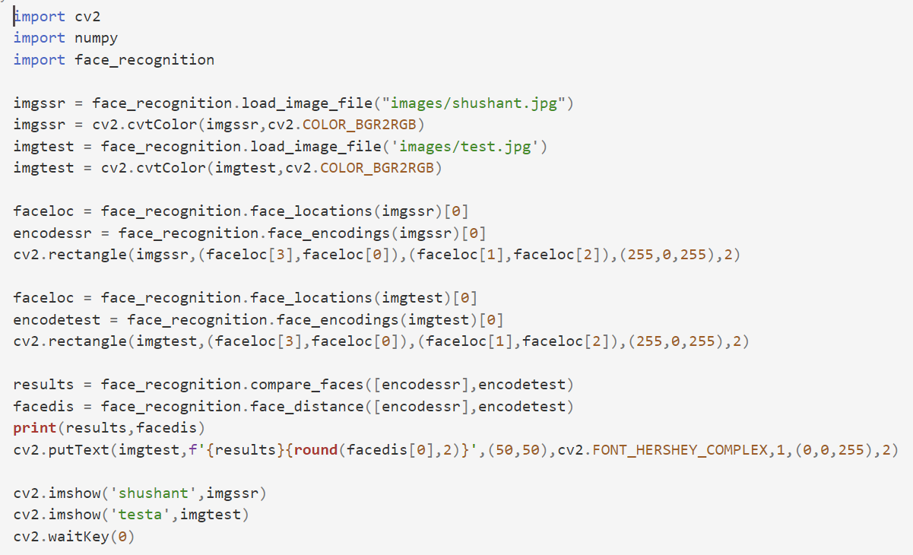

Slide 17
2. Building Face Attendance System
Now we are ready to build a Realtime face attendance system wherein webcam captured frames will be matched against the existing database images and if the match is found then it will store it in a CSV file called ‘Attendance.csv’ along with name and Datetime of capture.
Only once the file will store the matched image’s details, if the same image is received again then it’ll not update.
Path setting to the directory containing the image database. Read each image and the images array. Append the filenames into a list called Names and remove the extension.

Slide 18
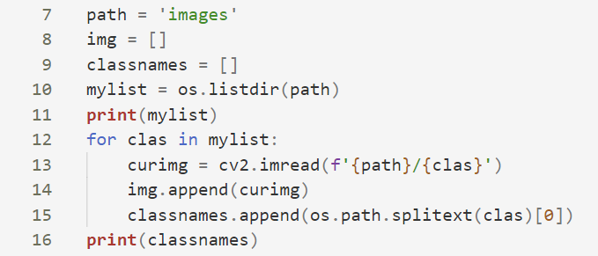
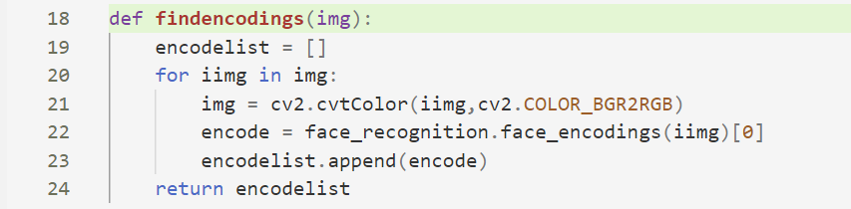
● Finding face encodings of images in the database and keeping them in a list to use later with incoming frames.
Capturing video fr3. Capturing video framesames

Slide 19
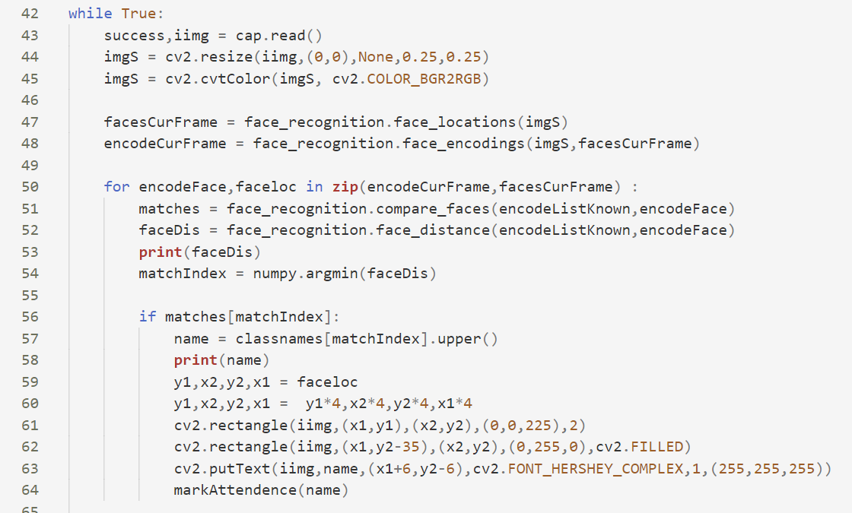
The same process is followed by the first detection face location then getting the face encoding values.
4. Now the incoming images are tested against the previously-stored encodings.Then the face distance is also computed. Lastly, we call the Attendance function along with the person name who is identified.

Slide 20
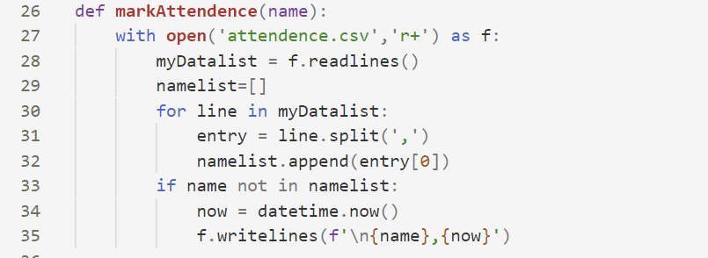
5. Reading from attendance file, Storing data (Name and Date Time of entry)

Slide 21
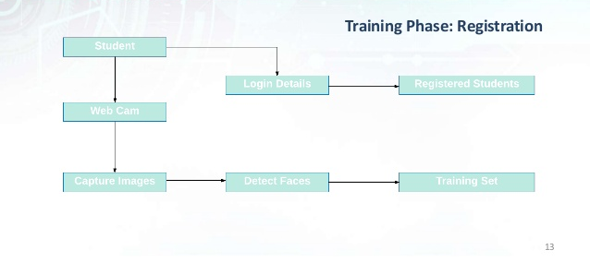
SYSTEM ARCHITECTURE Training Phase : - Registration

Slide 22
FEATURES
The system stores the faces that are detected and automatically marks attendance.
Provide authorized access.
Ease of use.
Multiple face detection.
Provide methods to maximize the number of extracted faces from an image.

Slide 23
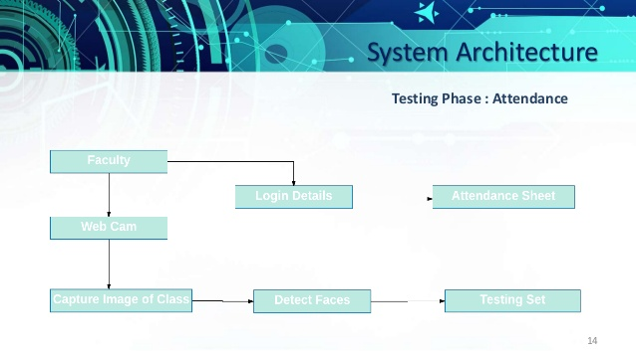
SYSTEM ARCHITECTURE Training Phase : - Attendance

Slide 24
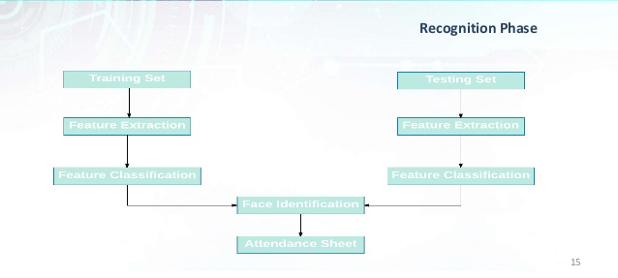
SYSTEM ARCHITECTURE Recognition Phase : -

Slide 25
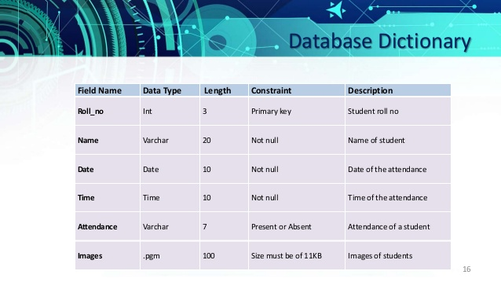
DATABASE DICTIONARY

Slide 26
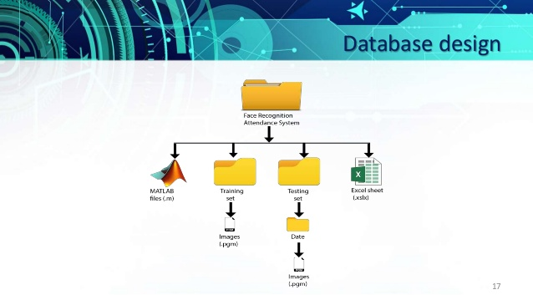
DATABASE DESIGN

Slide 27
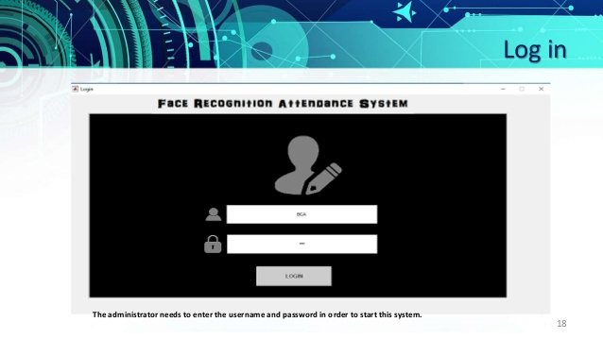
LOG IN

Slide 28
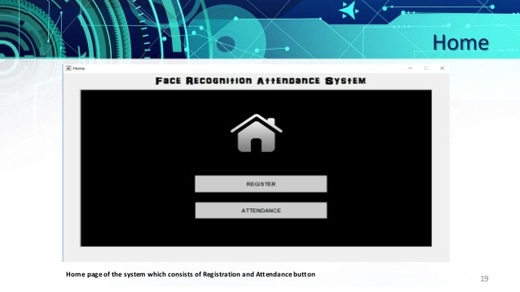
HOME

Slide 29
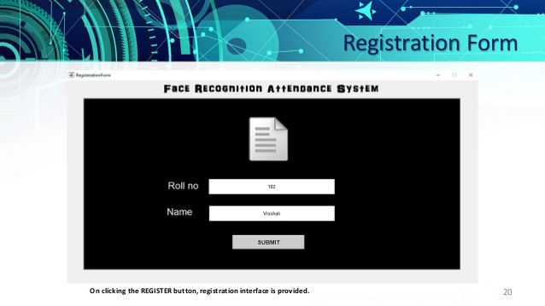
REGISTRATION FORM

Slide 30
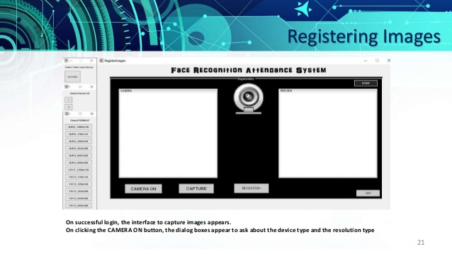
REGISTERING IMAGES

Slide 31
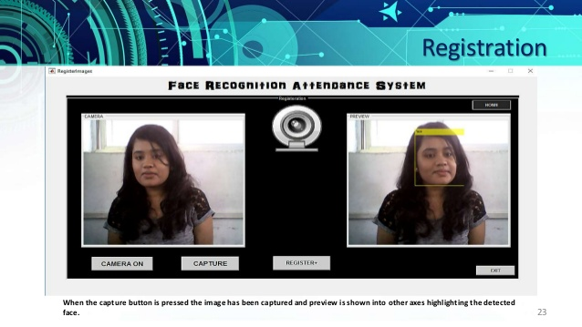
REGISTRATION

Slide 32
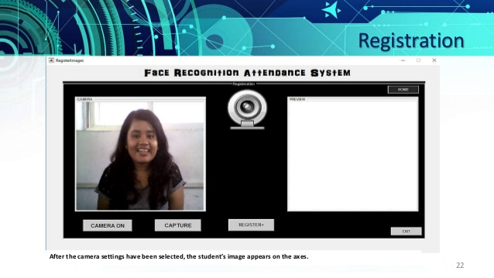
REGISTRATION

Slide 33
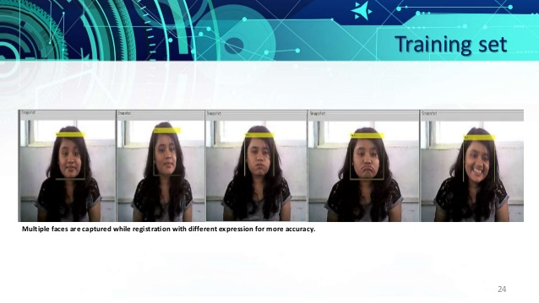
TRAINING SET

Slide 34
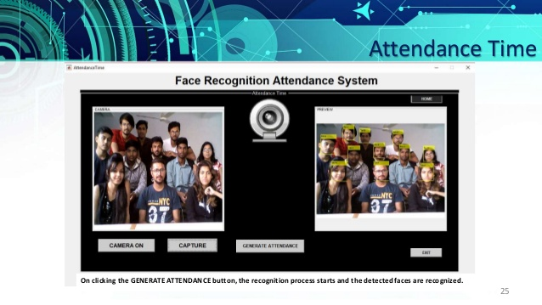
ATTENDANCE TIME

Slide 35
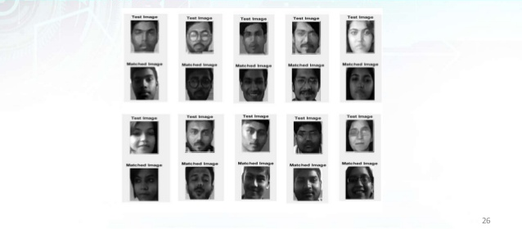
RECOGNIZED FACES

Slide 36
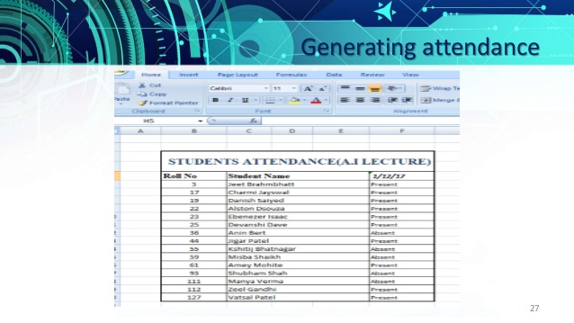
GENERATING ATTENDANCE

Slide 37
LEARNING AND EXPERIENCE
From scratch to working software , carrying out real-world software projects in our academic studies helps us to understand what we have to face in industry.
It was a wonderful experience working on face recognition attendance system with enthusiastic and like minded people where in we explored a part of artificial intelligence , i.e. image processing , which relates to our system from capturing images , images , detecting faces , storing them in a database , extracting facial features , recognizing them and generating attendance.
This project was a door to a stairs of success towards the bright software engineer career.

Slide 38
FUTURE ENHANCEMENT
We can make a web application by using FLASK and React JS so that students can interact with this technology in more efficient manner.
We can add more features like attendance seeing system for student.
We can also build the employee attendance management system.

Slide 39
CONCLUSION
Face detection library being a high-level deep learning library helps in identifying
faces accurately. We have used this to build a face attendance system which can
be helpful in offices, schools or any other place reducing manual labour and
automatically updating the attendance records in day-to-day life. This also notes
down the time of arrival thus can acquire information about people coming in late
after a specified time.

Slide 40
REFERENCES
www.google.com
www.wikipedia.com
www.w3schools.com
www.geeksforgeeks.org
www.tutorialspoint.com
docs.python.org/3/tutorial

Slide 41
THANK YOU

